Slide 1
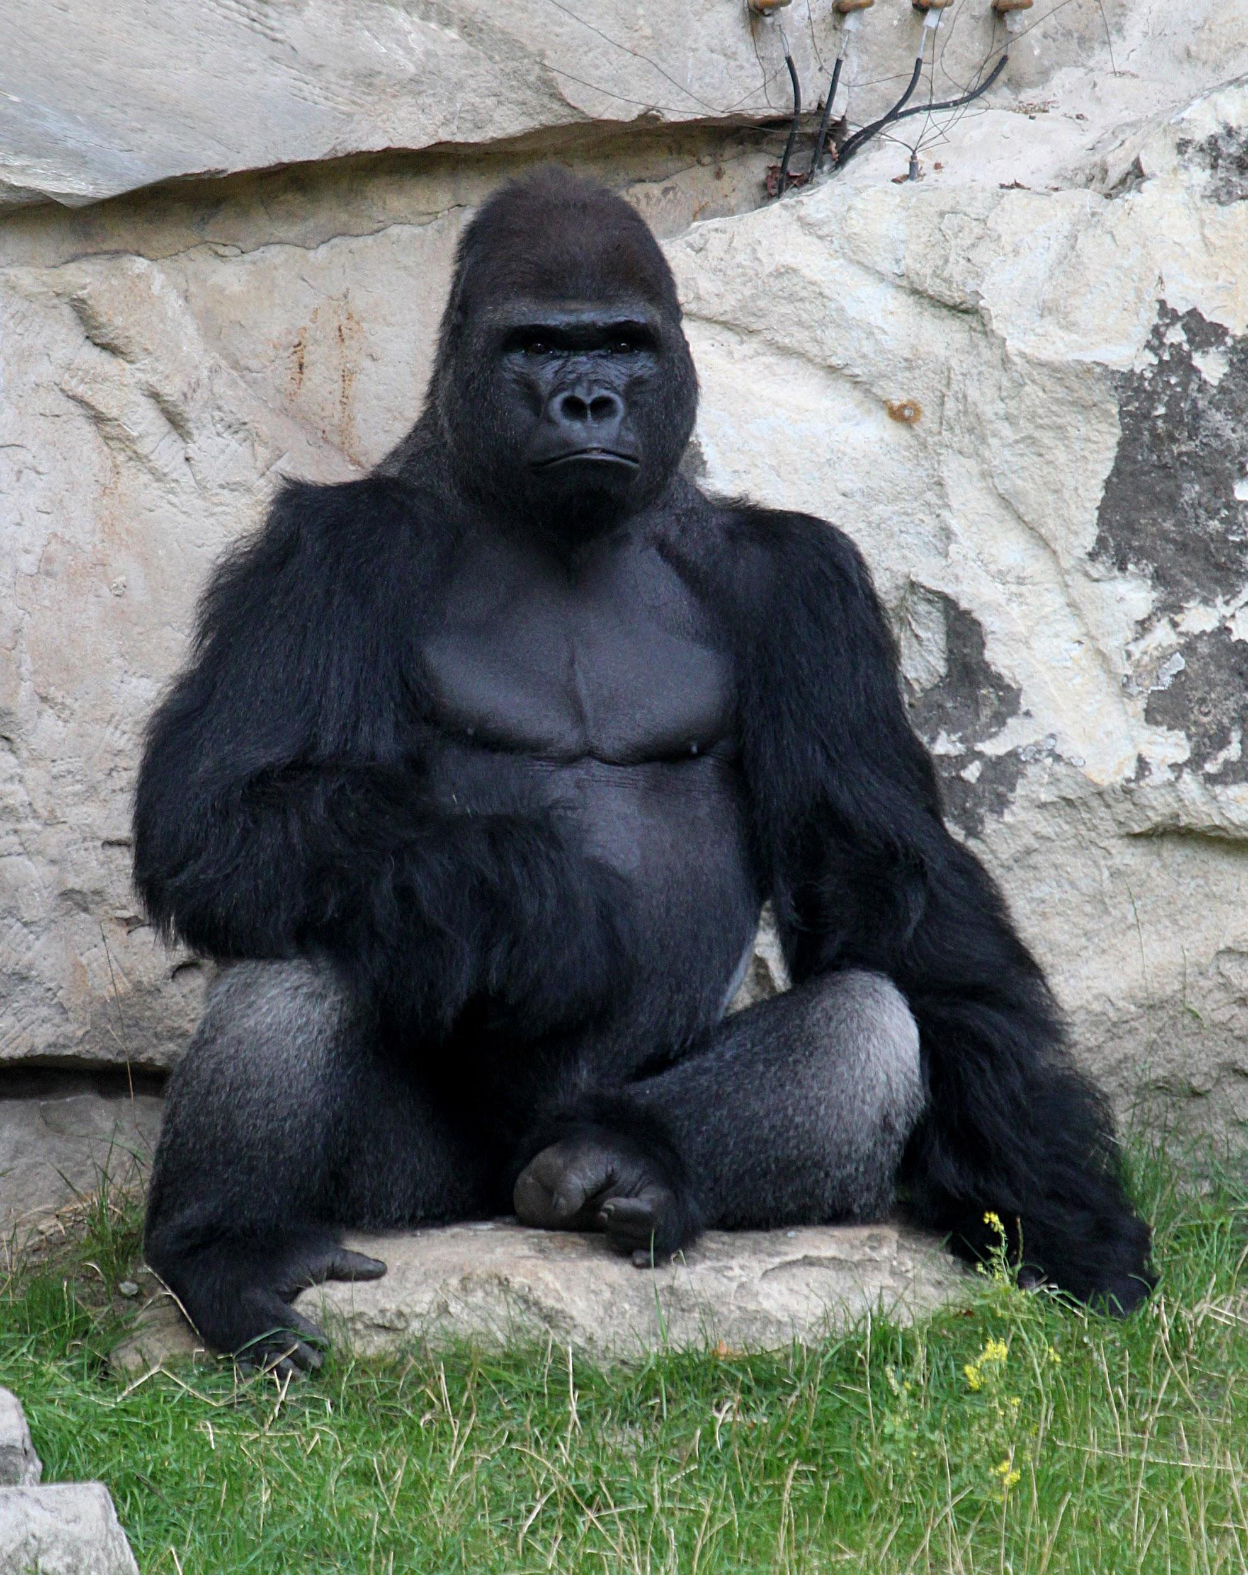
Do We Have the Right? is a collaborative digital book created by students who read The One and Only Ivan

Slide 2
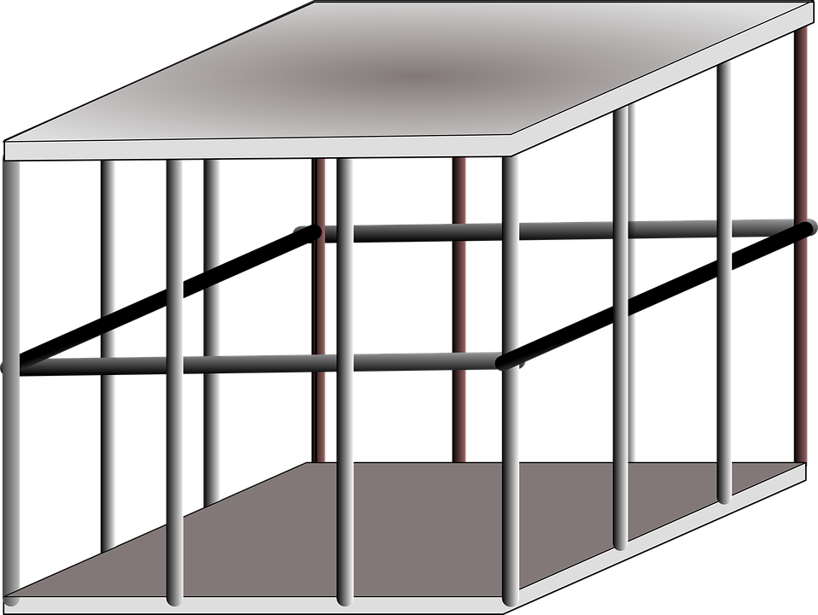
We had to answer the driving question:
Do we have the right to cage and capture animals?

Slide 3
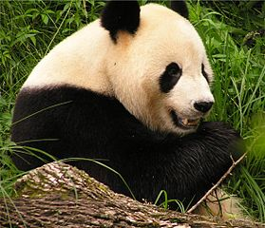
We then each researched endangered animals that are held in captivity like Ivan was….

Slide 4
Next, we needed to compare & contrast Ivan to endangered animals.
Lions
Tigers
Cheetahs
Sea Turtles
IVAN

Slide 5
We compared and contrasted the information we gathered about our animal to the way Ivan was held captive and caged, by explaining the similarities and differences in the way Ivan lived versus that of our chosen animals.

Slide 6
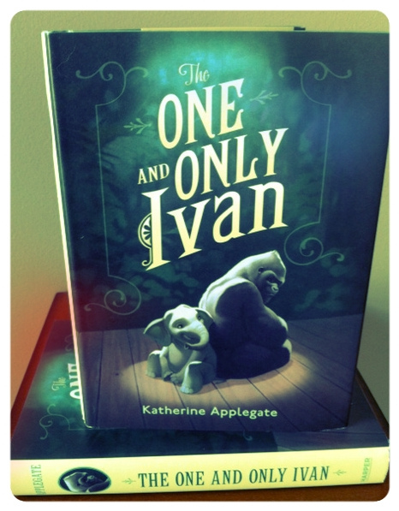
Finally we created our own own poems, haikus, and speeches about either the animals we have chosen or about Ivan.

